Slide 1

DIGITAL PORTFOLIO
School of Computer Science
and Engineering
Division of Cyber Security and Digital Forensics

Slide 2
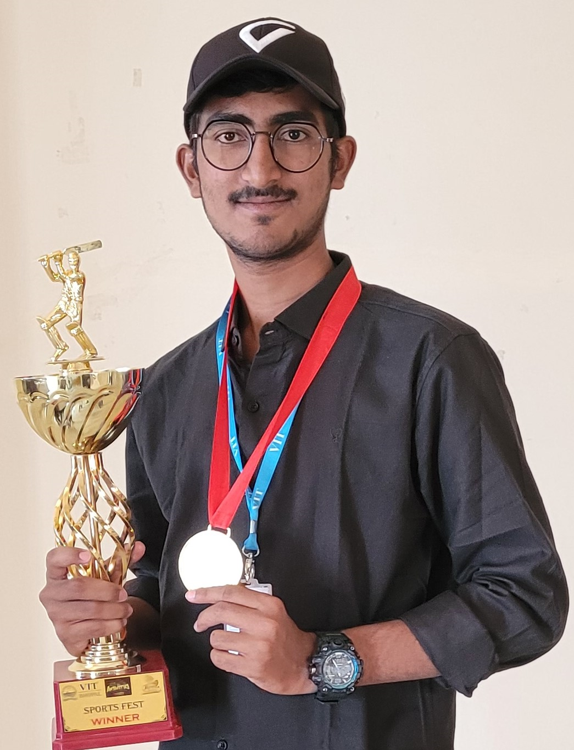
Karnati Phanindhar Reddy
20BCY10189
B.Tech in CSE with specialization in Cyber Security
and Digital Forensics

Slide 3
About Me
I am K Phanindhar Reddy, currently pursuing my Bachelor's degree in Computer Science and Engineering specialization in Cyber Security and Digital Forensics from VIT Bhopal University.
To build a dynamic career in the field of cybersecurity,and to contribute to the security and integrity of digital systems of an organization while continuously expanding my knowledge.
Keen interest in Cricket, Volley Ball, Reading Articles and Writing Blogs in Medium related to Cyber Security, Prompt Engineering, Bug Hunting, Reading Novels.
I have done an internship from CYBERSEC INFOTECH and Gained hands-on experience in ethical hacking and penetration testing.

Slide 4


Educational Background
10th : 93% 12th : 94.7 CGPA
St. FRANCIS E M H School, Telangana NARAYANA Junior college, Hyderabad
8.45 CGPA
CSE specialization in
Cyber Security and Digital Forensics

Slide 5
Technical Skills
Penetration Testing
JavaScript
Bash Script
Python
Linux
OSINT
MySQL
Vulnerability
Assessment
Web Application

Slide 6
My Projects
Research and Analysis on Fake Image Manipulation Detection Third Party Risks and Security Management
Mobile Security Threats using Neural Networks
Research on Cyber Attacks and Mitigation Strategies DUAL LOCK DOOR SYSTEM (EPICS)

Slide 7
Research and Analysis on Mobile Security Threats
Research and Analysis on Mobile Security Threats, I wrote a HTML code using VSCode which gathered all CVE’s at one place in website, it is named as website “mobile app CVE’s found today”.
The purpose of writing this script was to get familiar Gathered vulnerabilities which will effect our mobiles.
This HTML code is used for showing the Common Vulnerabilities and Exposures(CVE) system is the most widely used reference for publicly known software vulnerabilities and is accessible through the U.S. Government’s National Vulnerability Database(NVD).
I have used Terminal or command prompt to Navigate to the Directory which is ‘cd’ , then Running the script. Then I Excuted the script which will start downloading the NVD CVE feeds for each year from 2021 to the current year CVE’s. It will process the data and generate an HTML report.
Technologies used are HTML, Python, IO, Json, sys, urllib.request, Zipfile Modules, NVD.

Slide 8
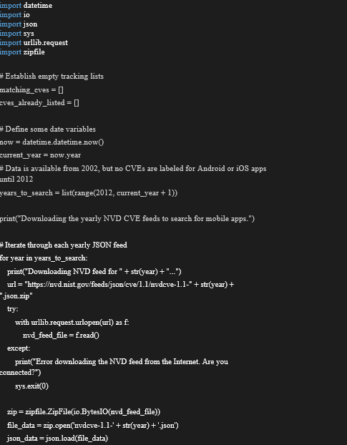
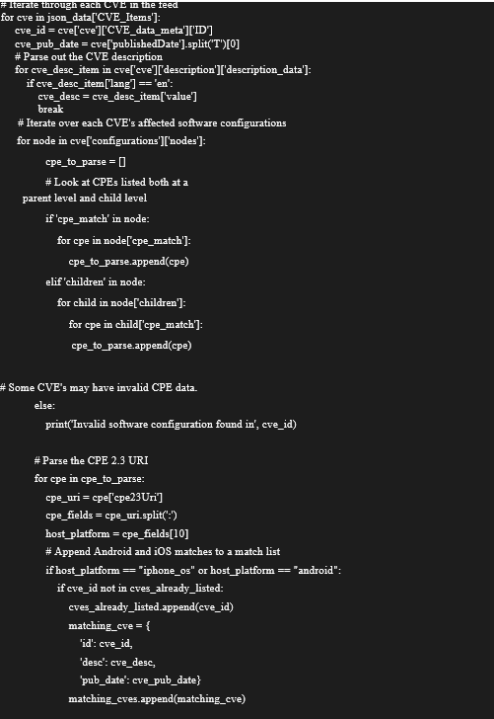
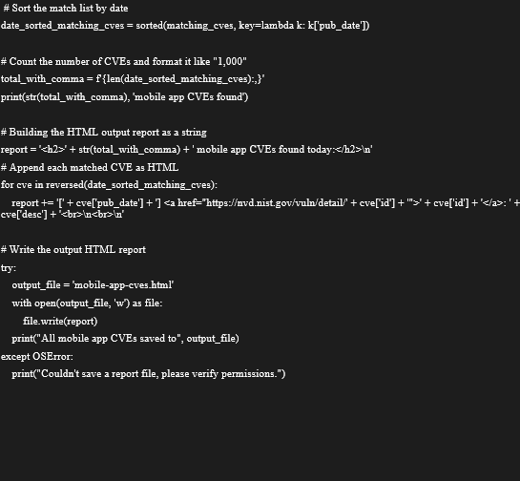

Slide 9
Fake Image Manipulation Detection using Neural Networks
We made a web-based platform for the user to upload the video and classify it as fake or real. Our approach for detecting the DF will be great contribution in avoiding the percolation of the DF over the world wide web.
Technologies used are Django Application, Model Creation, Documentation, Google Colab, Python.
This project can be scaled up from developing a web-based platform to a browser plugin for automatic DF detections. Even big application like WhatsApp, Facebook can integrate this project with their application for easy pre detection of DF before sending to another user.
This projects aims in detection of video deepfakes using deep learning techniques like ResNext and LSTM. We have achieved deepfake detection by using transfer learning where the pretrained ResNext CNN is used to obtain a feature vector, further the LSTM layer is trained using the features.
A deepfake detection method using convolutional neural network (CNN) and long short term memory (LSTM) to extract temporal features of a given video sequence, which are represented via the sequence descriptor.

Slide 10
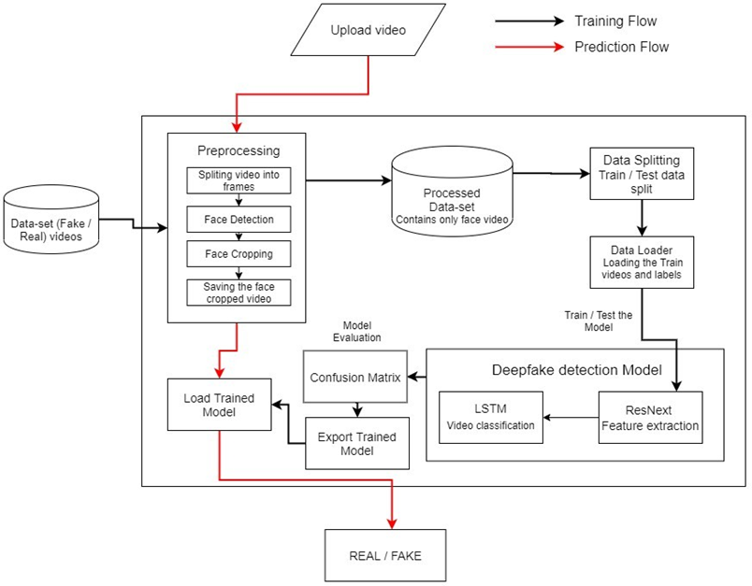
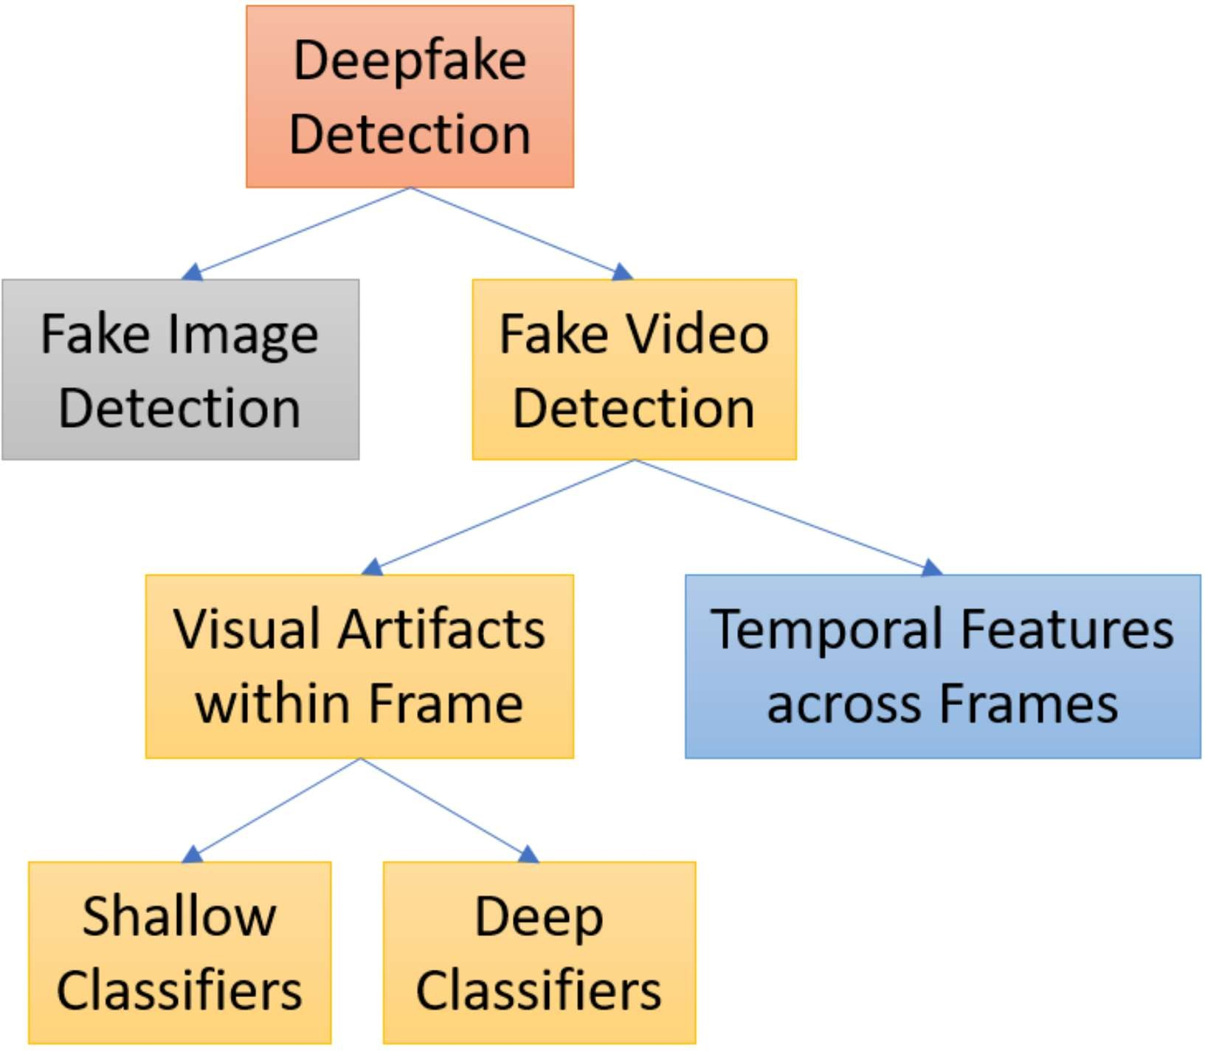
Deepfake Detection Flow chart

Slide 11

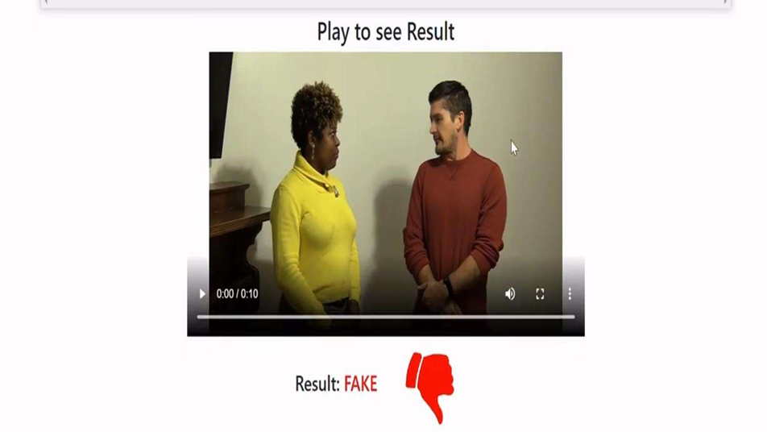
WE HAVE TO UPLOAD VIDEO IN WEB APPLICATION.
After Testing we will get Result whether it is Real or Not.

Slide 12
Third Party Risks and Security Management (CyberClinic)
Third Party Risks and Security Management, is a Research project of Cyber Third-Party Risk Management in which I wrote a Research paper by Gathering Other risks management processes.
It is the practice of identifying and reducing risks related to outsourcing to third party vendors or service providers is known as third-party risk management (TPRM).
The topic of third-party risk includes a wide variety of digital threats. These could include dangers to finances, the environment, reputation, and security. Due to vendors’ access to intellectual property, sensitive data, personally identifiable information (PII), and protected health information, there are dangers involved (PHI).
I have also used Working Mechanism with steps to do Third Party Security.
1. Analysis, 2. Engagement, 3. Remediation, 4. Approval, 5. Monitoring.
I have used Comparison of parameters with Key contribution and Different Authors ideas.

Slide 13
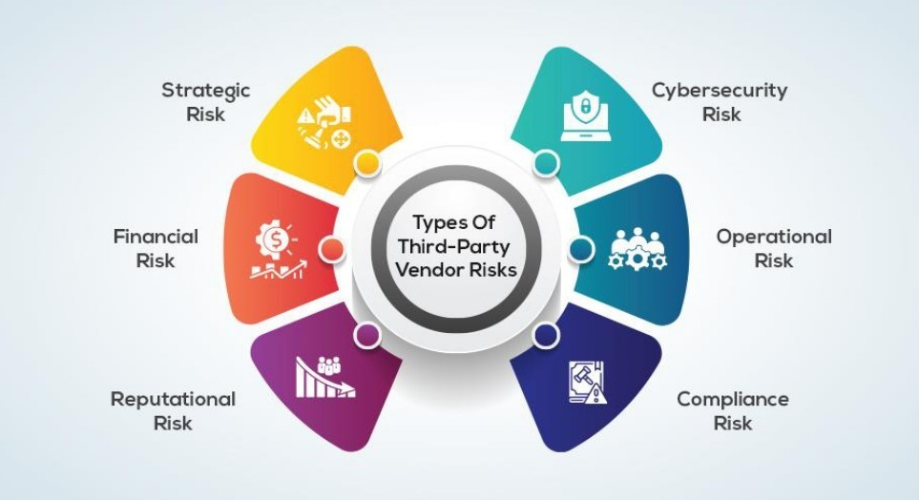
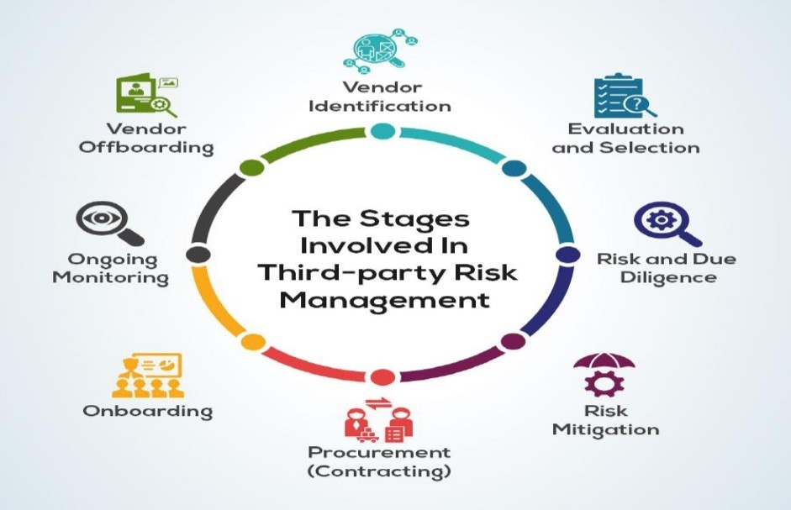
The Stages Involved in Third-party Risk Management
Types of Third-Party Vendor Risks

Slide 14
Research on Cyber Attacks and Mitigation Strategies
Research on Cyber Attacks and Mitigation Strategies, This is research project on the advent of digital media, Internet, web and online social media has drawn the attention of relevant research community significantly and created many new research challenges on cyber security.
This paper discuss the recent cyber security-attacks and the economic loss resulted from the growing cyber-attacks and also analysis the increasing exploitation of a computer system, which has created more opportunities for the current cyber-crimes.
I have used Mitigation process for DROWN attacks to minimize the possibility attacks, server operators need to ensure that their private keys are not used anywhere with server software that allows SSLv2 connection.
I have Researched on different kinds of cyber-attacks, that shows the percentage of cyber-attacks happened worldwide recently in May 2016,which indicates that the most frequently occurring cyber-attacks are malware, Distributed Denial of Service , targeted attack, SQL injection(SQLi),defacement, malvertising and others.
Technologies used DIS, Software Patching, Multi-factor authentication systems, Sandbox, IDS, Firewall, Content filtering, Update and monitor black/block list.

Slide 15
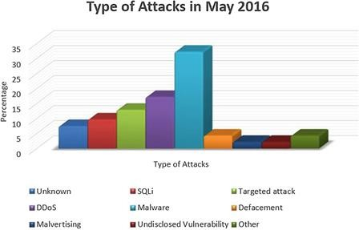
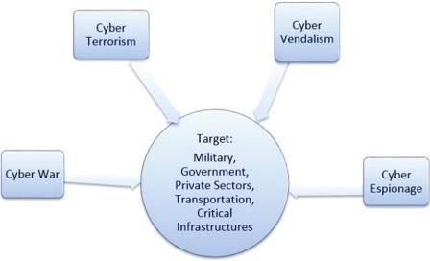
Types of Attacks

Slide 16
Dual Lock Door System
EPICS Project (Dec 2022 – May 2023)
Our aim was to advance a feature of double security with Face Recognition and one time password generator by the voice assistant “Dodo”. So, it reduces the chance of password generator by the Voice assistant “Dodo”. So, it reduces the chance of password hacking by unauthorized users or intruders.
I have worked on creating the Lock.py module, which has the necessary code to validate the user&#39;s face and produce the OTP. This might entail developing software to communicate with a facial recognition API and setting up a method for creating and communicating the OTP with the user. I also implemented the code for system testing and analysis, making sure the face recognition and OTP generation modules were accurate and functioning properly.
We built a software in such a way to serve people and provide them some privacy by providing an advanced lock system for their workplace and meeting rooms.
Lock systems required human work to keep a track of every individual back in the day, with facial recognition a considerable amount of work is reduced, as computers manage authorization of users, keep logs and also provide high-level security.

Slide 17
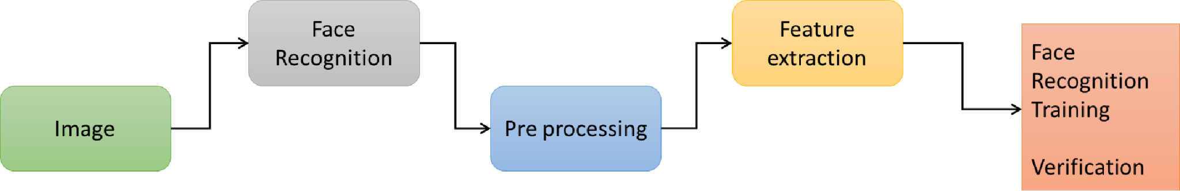
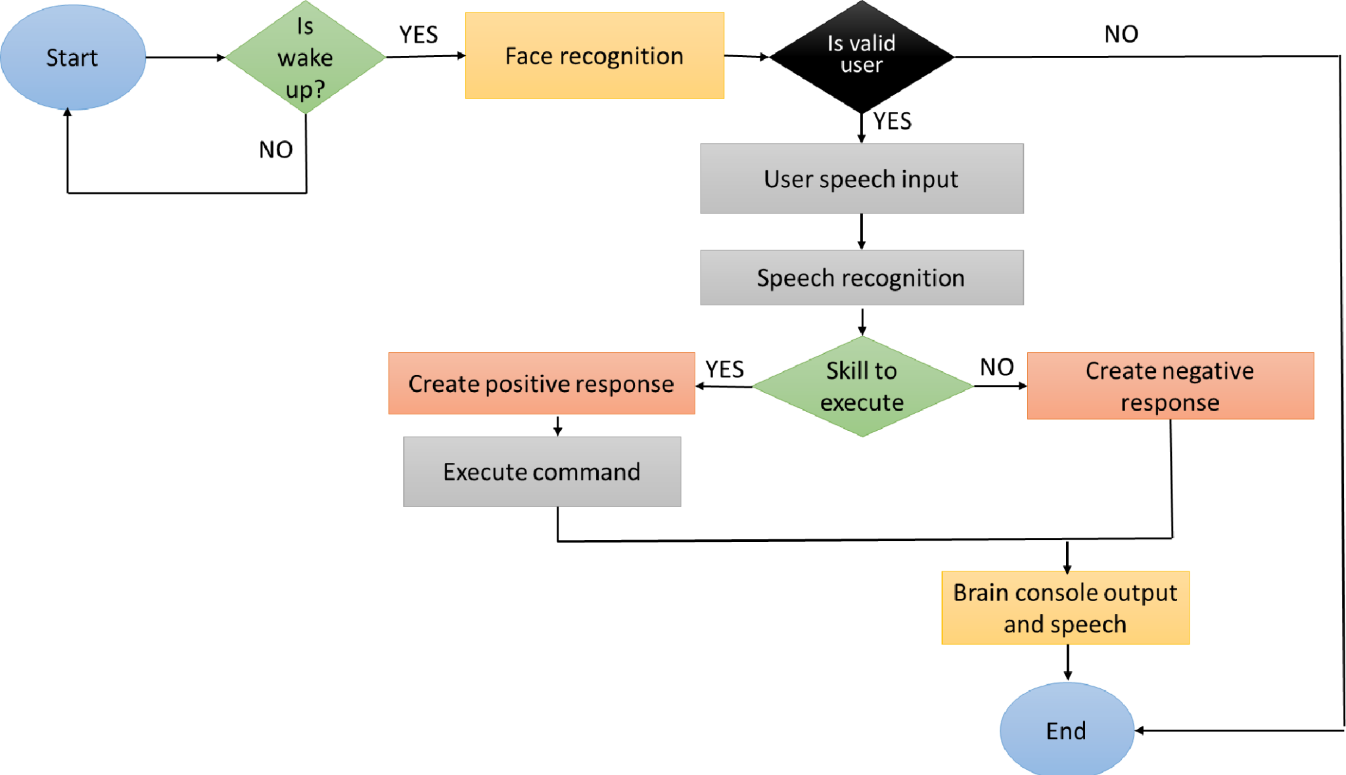
Architecture
Diagram
for Face Recognition

Slide 18
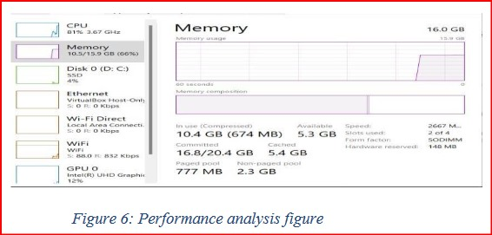
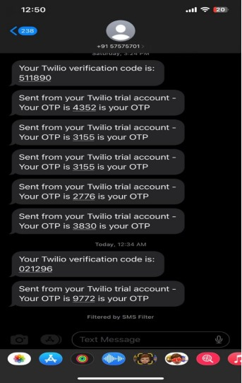
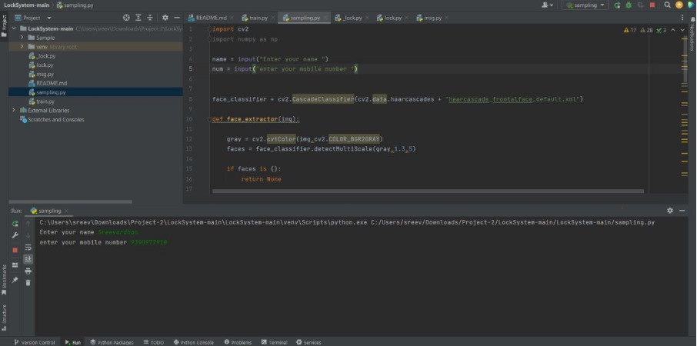

Slide 19
Malware Analysis Home-Lab for Trojan Analysis
Capstone Project – Ongoing
This project aims to create a Malware Analysis Home-Lab that leverages the power of FLARE VM and Remnux to comprehensively analyze Trojans, helping us understand their characteristics and determine their impact on a system.
We Employ dynamic analysis tools to run the Trojan in a controlled environment, monitoring its behavior to determine its impact on the system.
The problem we aim to address with this project is the rising sophistication of Trojan-based malware, which poses a grave threat to the security of computer systems. Traditional security measures, such as Windows Defender and other anti-malware software, are often inadequate in detecting and mitigating these threats. To effectively combat Trojans, it is crucial to develop a controlled and secure environment for their analysis.

Slide 20
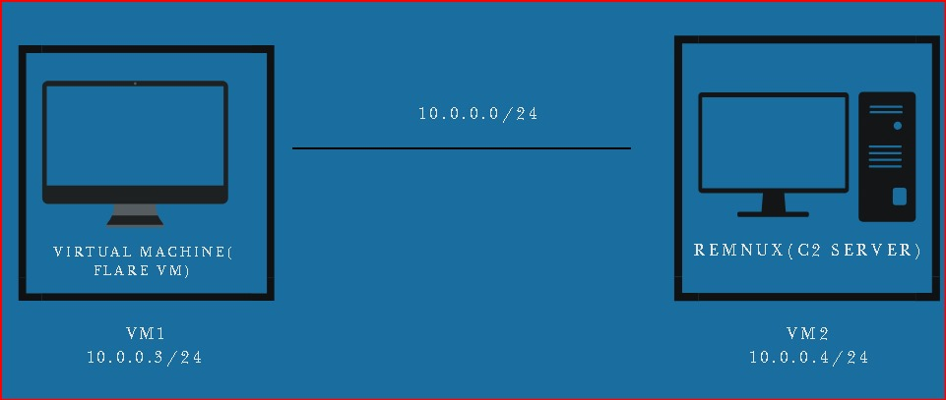
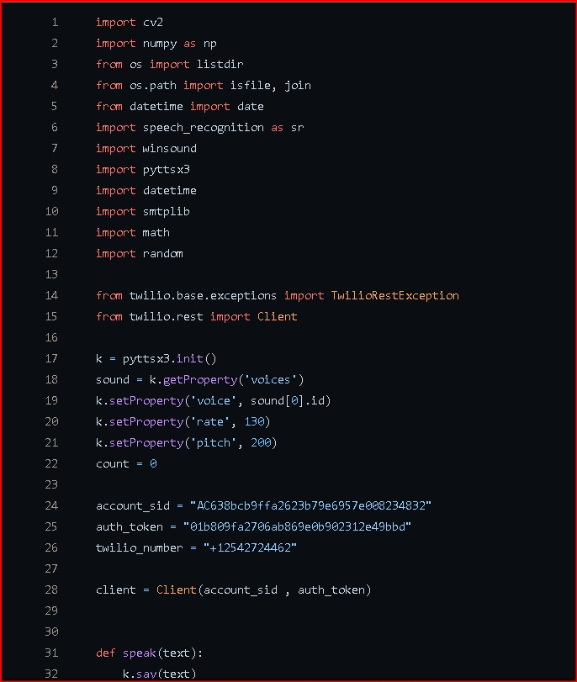
FLARE VM and Remnux

Slide 21
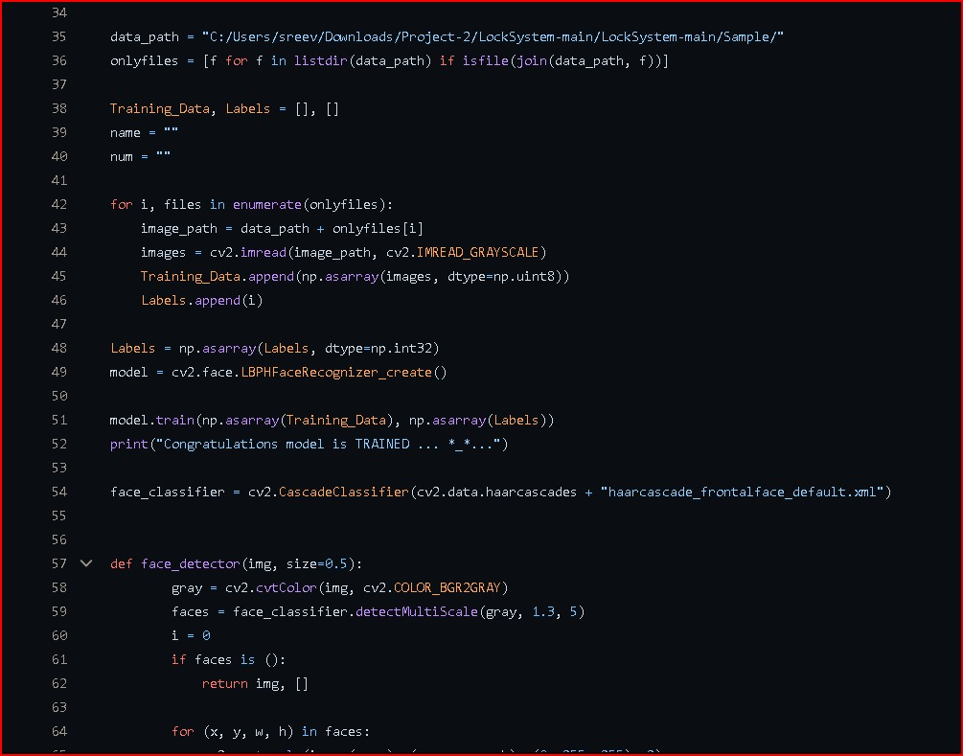
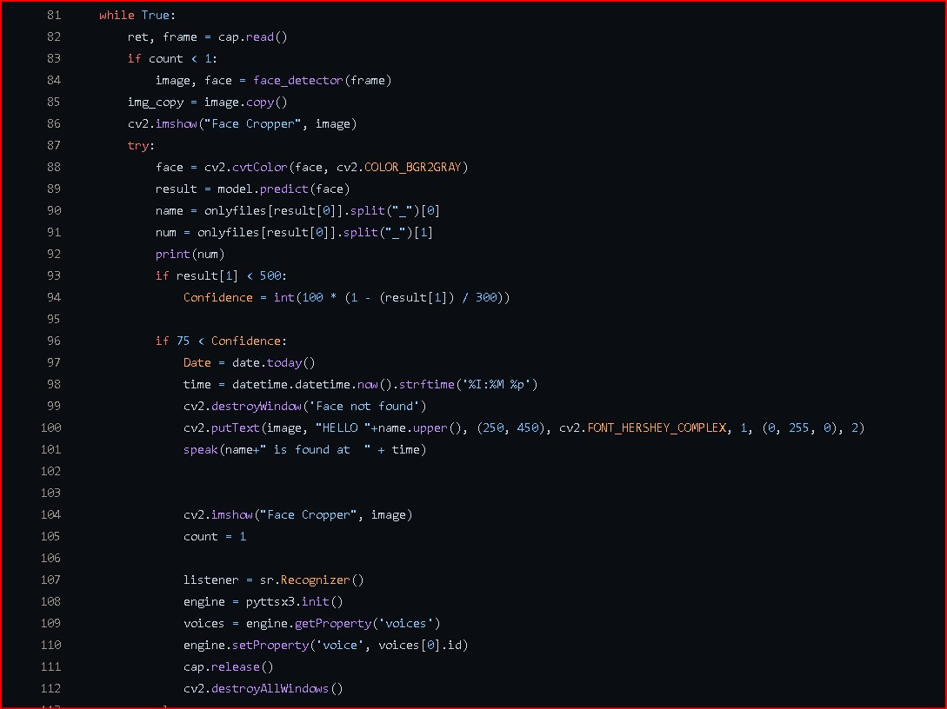

Slide 22

Work Experience

Slide 23
Teachnook
Teachnook is a Ed-Tech Startup and upskilling Platform
worked in close coordination with Testing teams.
solved doubts of multiple students.
participated in daily meetings and discussion.
participated in multiple learning sessions by Teachnook.
worked on the social media websites Testing.

Slide 24
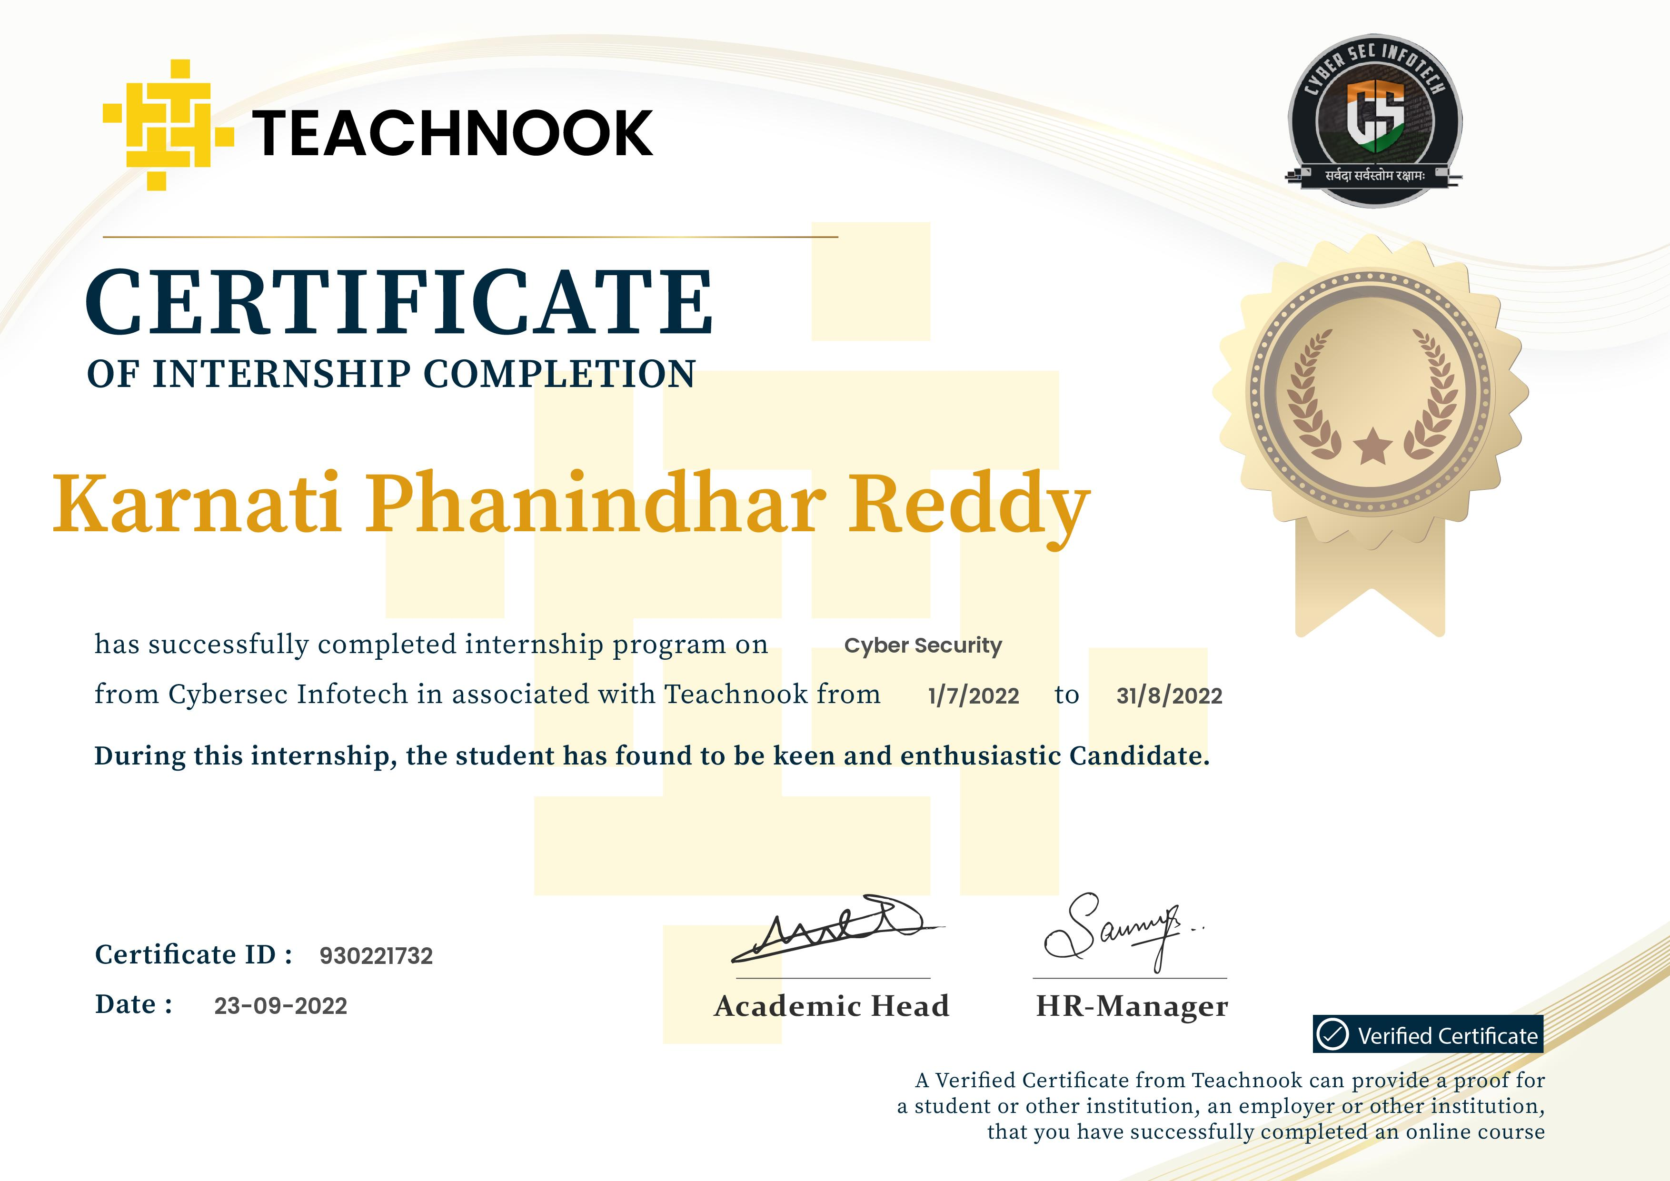
INTERNSHIP CERTIFICATE

Slide 25
SISTMR Australia
SISTMR is a Ed-Tech Startup and upskilling Platform
Worked in close coordination with Testing teams.
Solved doubts of multiple students.
Participated in daily meetings and discussion.
Participated in multiple learning sessions by VPKBIET BARAMATI INDIA.
Worked on the social media websites Testing.

Slide 26
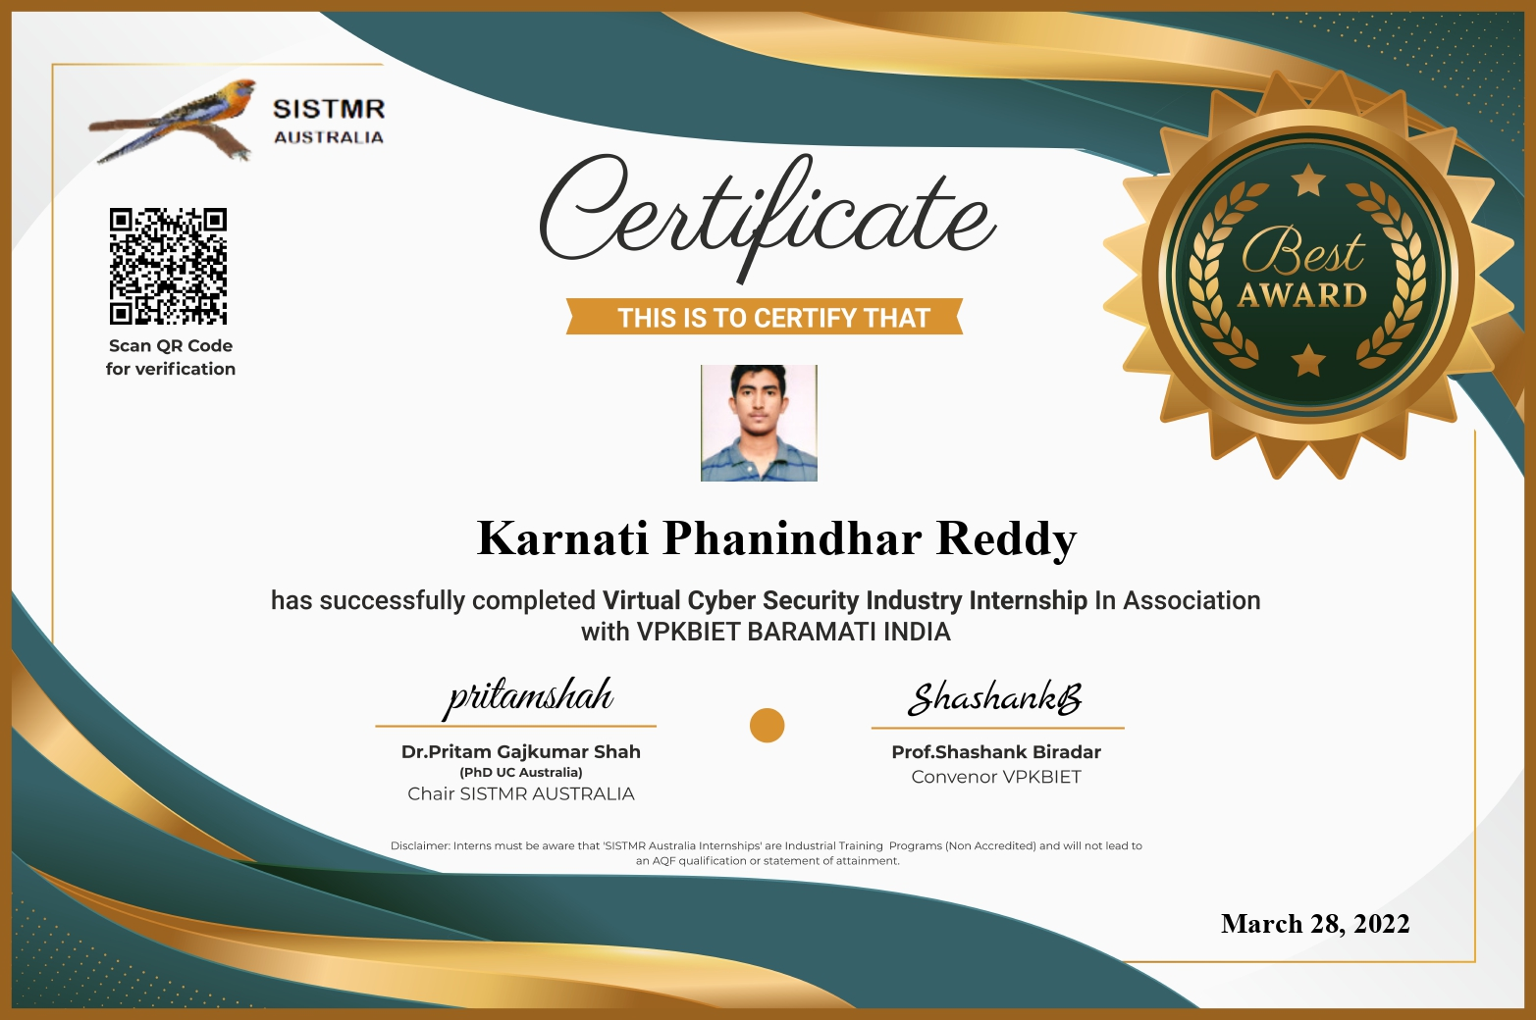
INTERNSHIP CERTIFICATE

Slide 27
Courses and Certifications

Slide 28
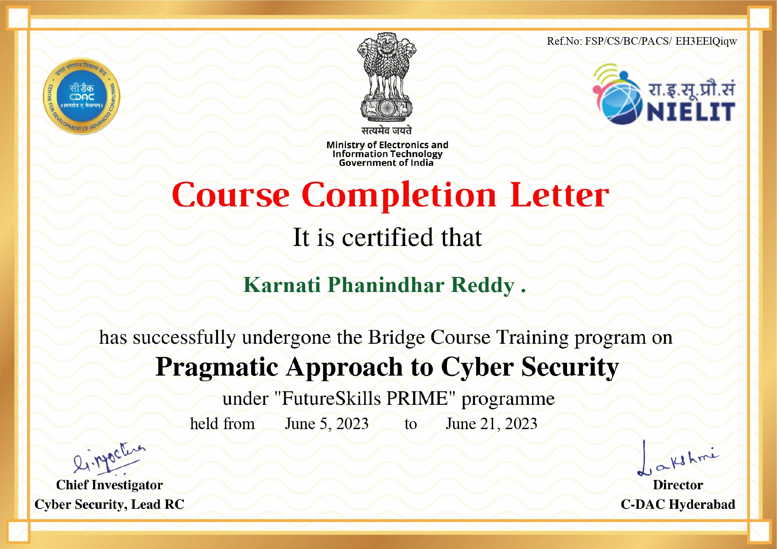

Slide 29
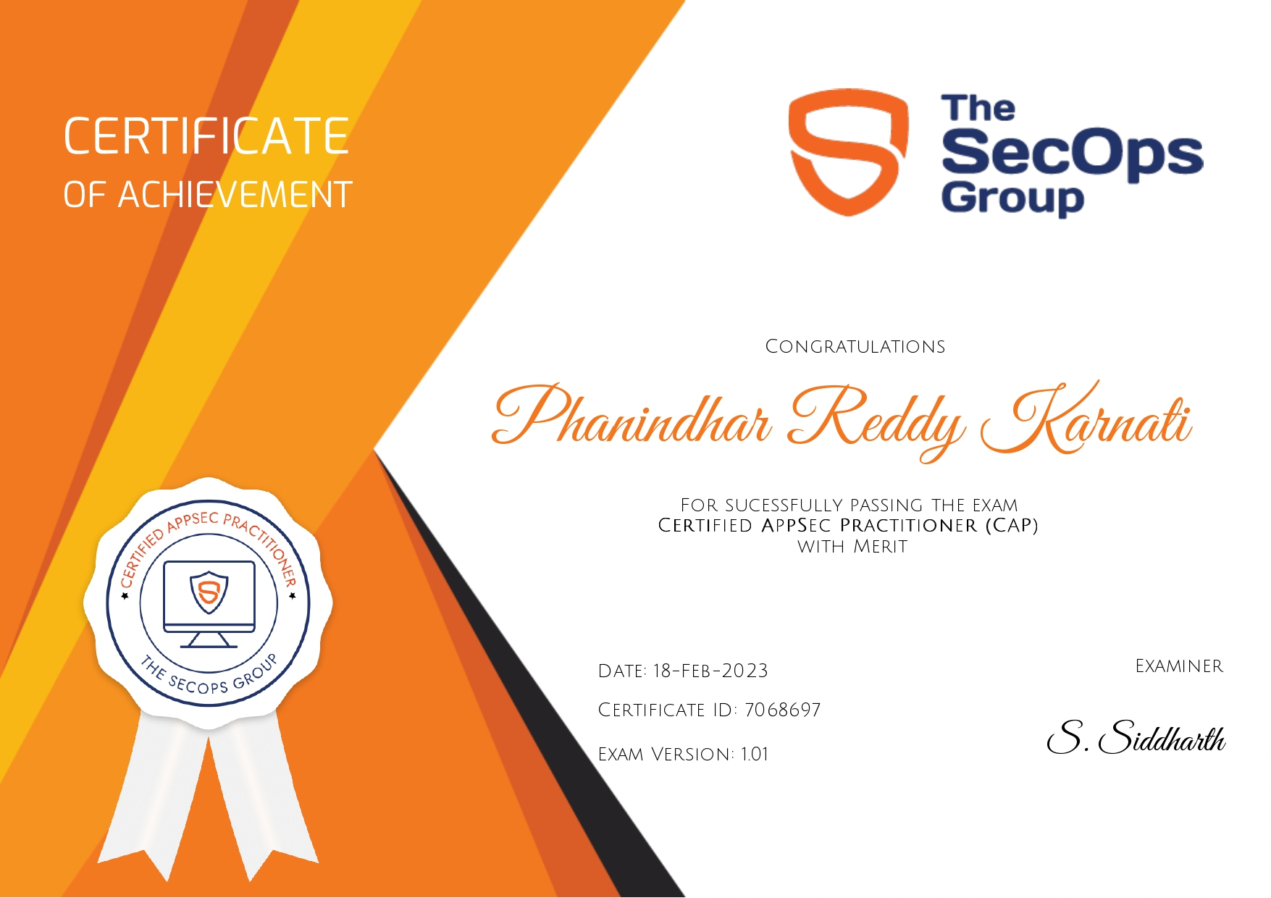

Slide 30
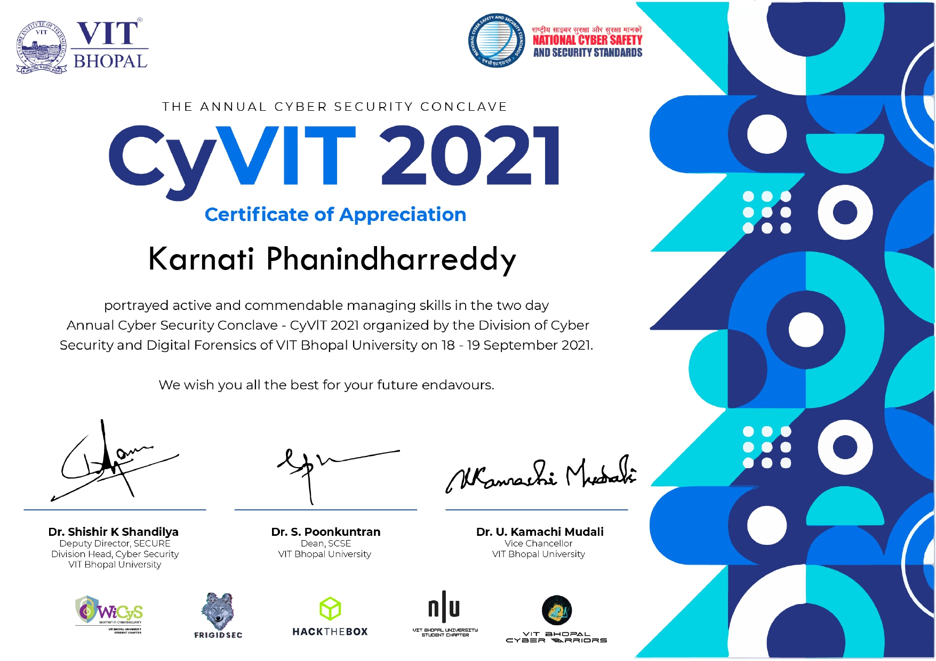

Slide 31
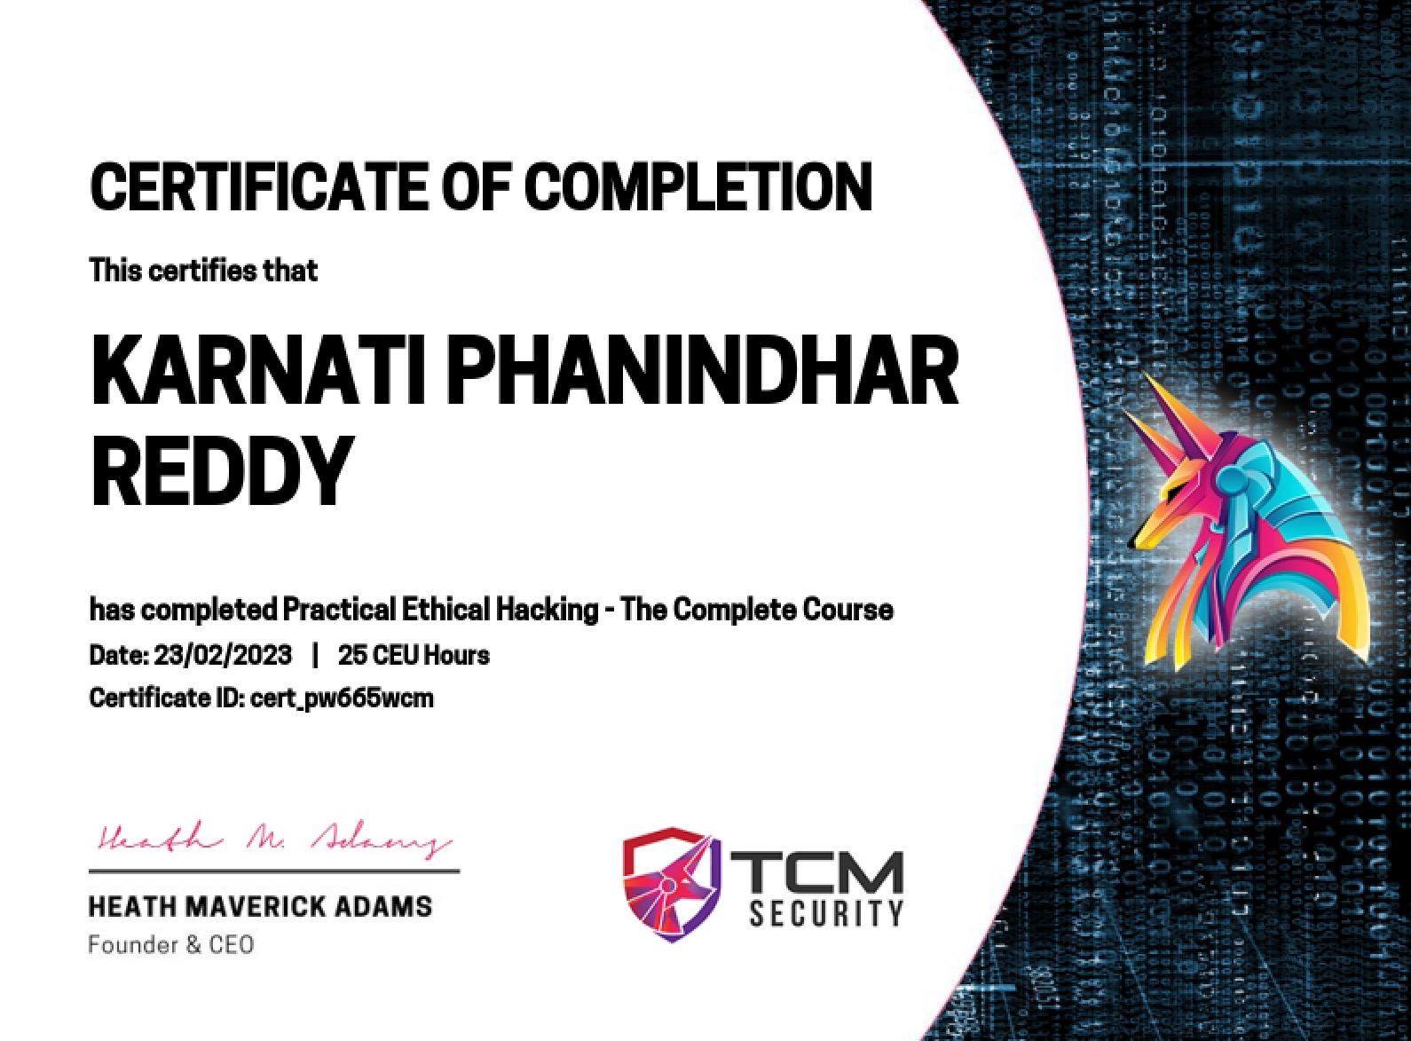

Slide 32
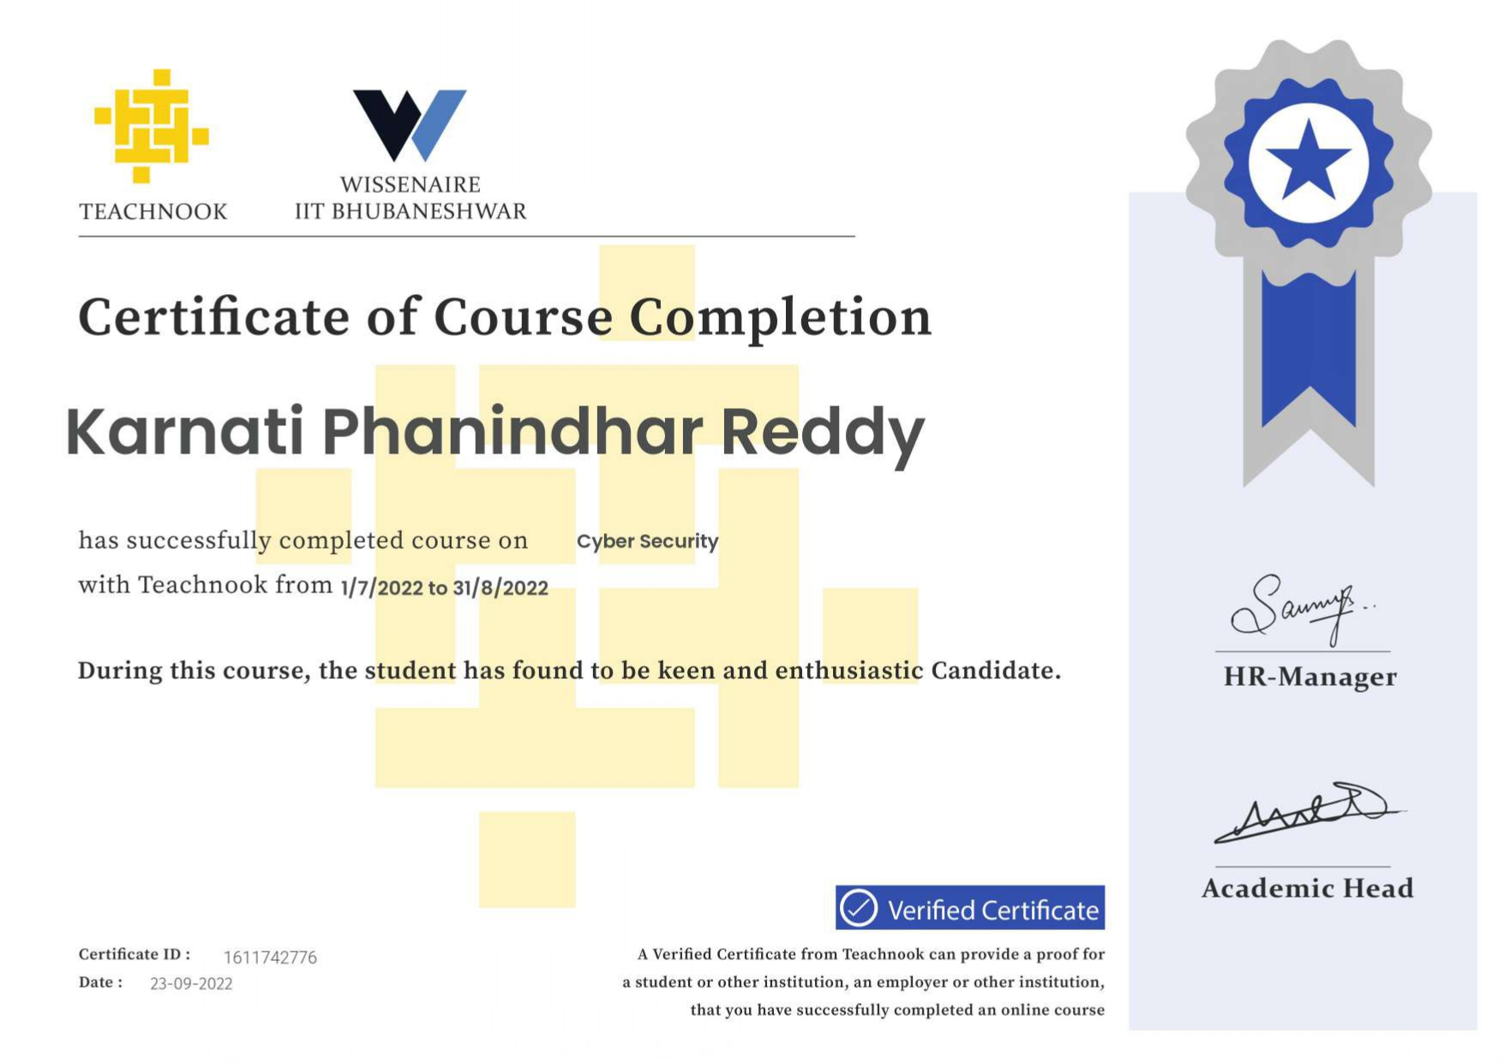

Slide 33
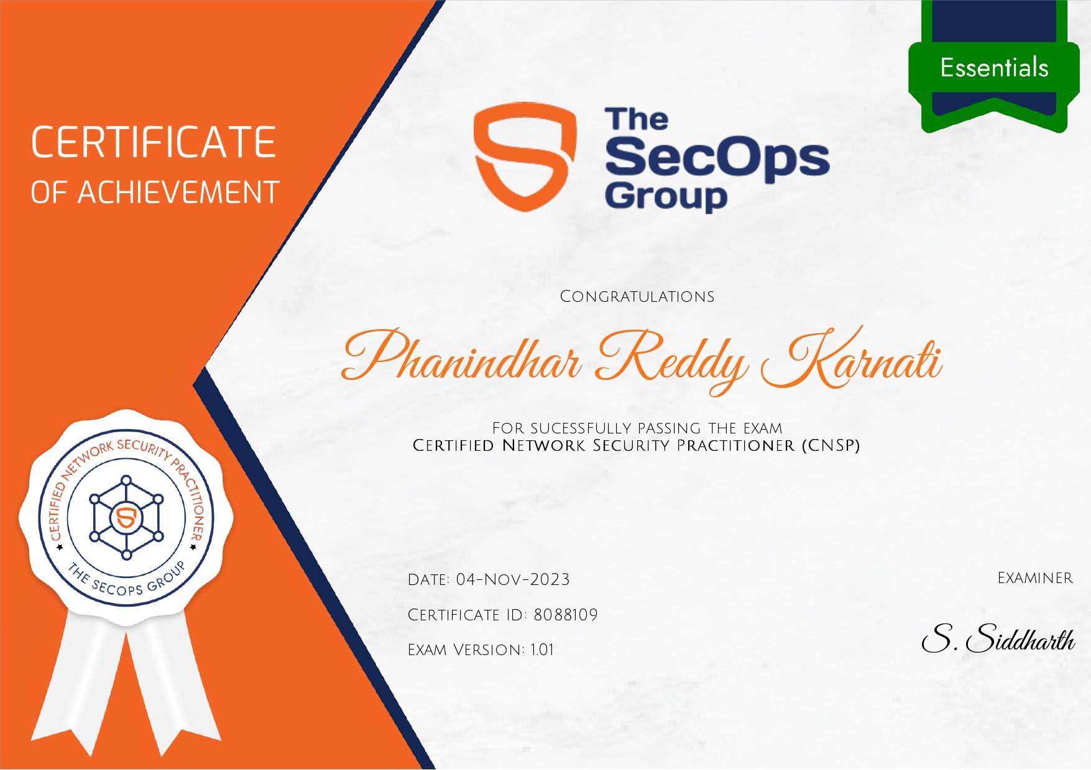

Slide 34
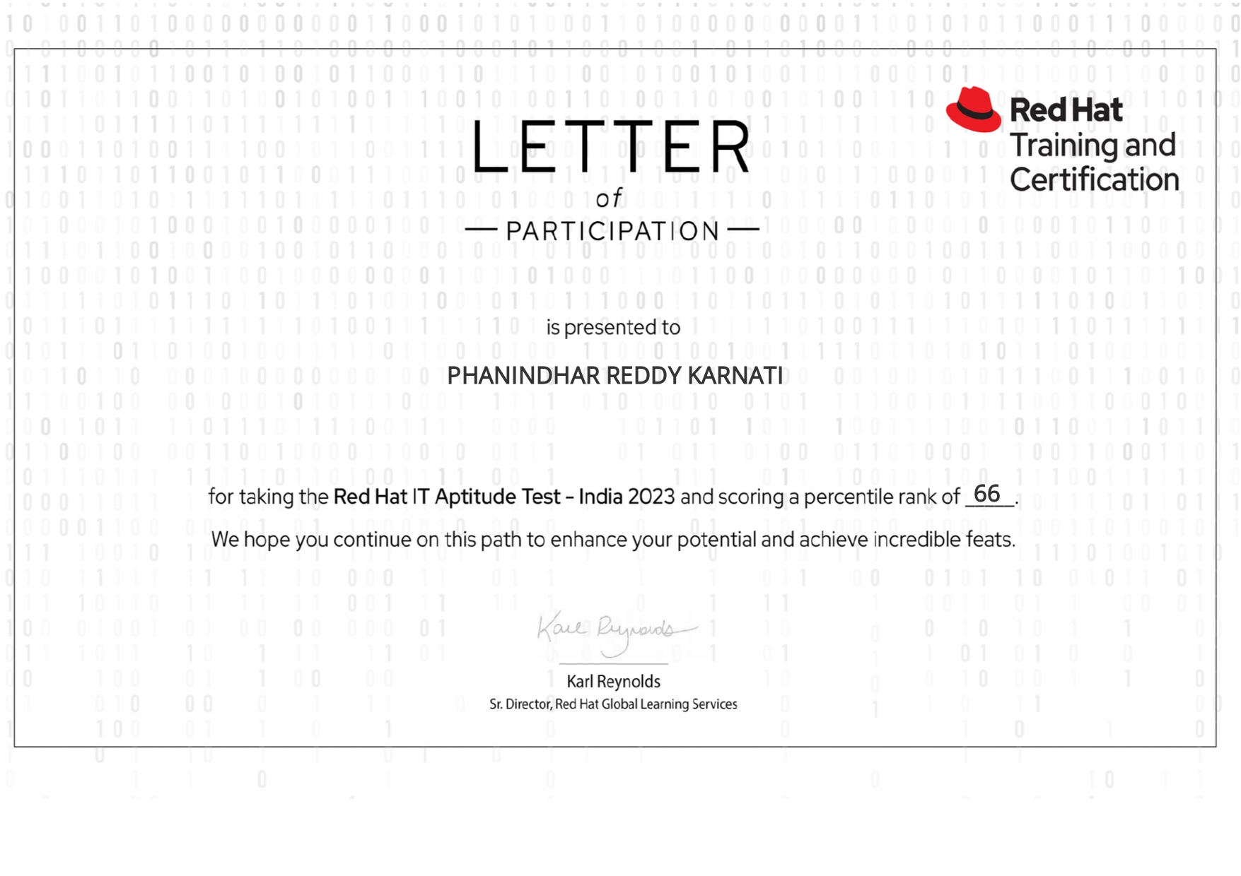

Slide 35
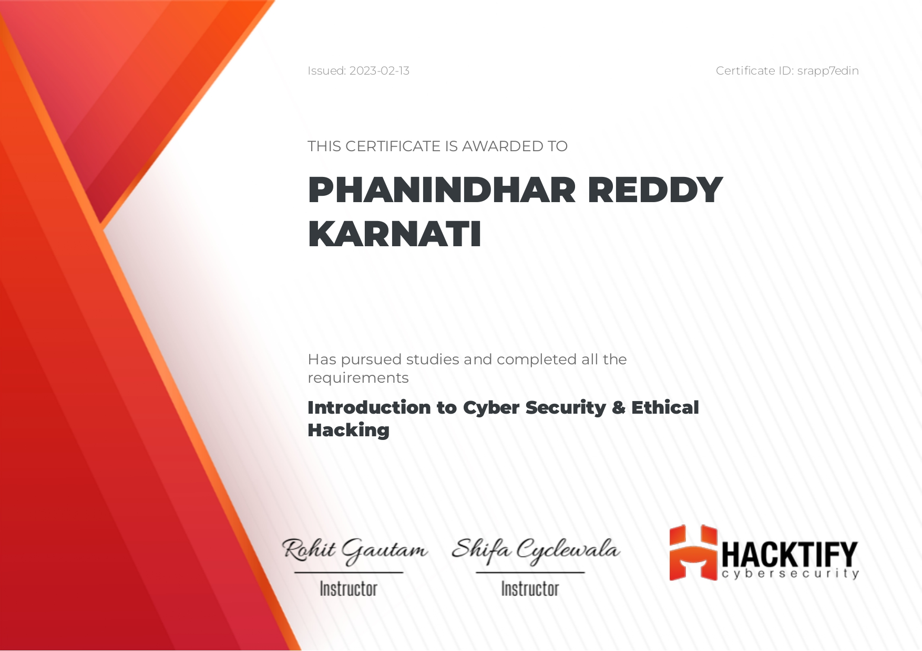

Slide 36
Position of Responsibilities and Achievements
RED HAT Aptitude Test – India 2023.
An active member of my college Sports Club.
Core Member of AdVITya (Inter University Techno-cultural Festival) (Jul 22 – Aug 22).
Winner, AdVITya Cricket tournament (Intra-University cricket match) (April 22) & (April 23).
SECOPS Certified: APPSEC Practitioner(CAP).
SECOPS Certified: Ethical Hacking: Nmap in Depth
School Band Music member.

Slide 37
Contact Information
Contact no : 9392309778
Email id : karnatiphanindhar2002reddy@gmail.com
LinkedIn : https://www.linkedin.com/in/phanindharreddykarnati/
GitHub : https://github.com/phani778

Slide 38
Thank You

